Slide 1


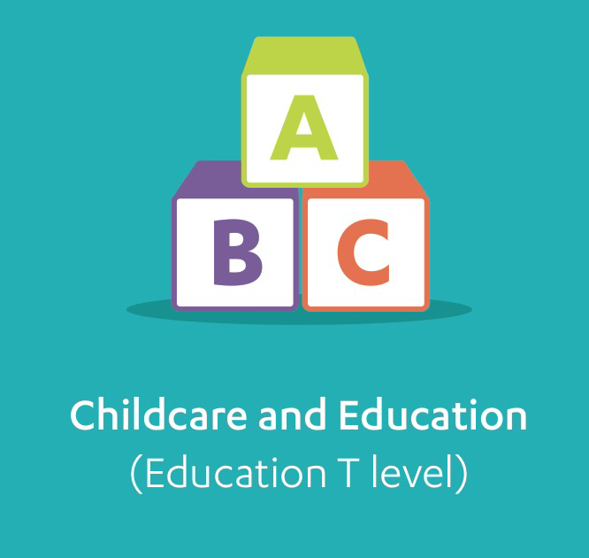


Childcare and Education and Digital: Digital Production, Design and Development
T level
Delivery in 2020

Slide 2


What is a T level
T Levels signify a big change in technical education
They will become one of the main choices for students post-16, alongside A levels and apprenticeships.
Equivalent to 3 A levels, the 2-year courses have been developed in collaboration with employers and businesses to ensure the content prepares learners for the world of work and meets industry needs.
The Education and Childcare strand seeks to also provide a licence to practice (to be included in staff numbers) within early years settings
The awarding organisation is NCFE CACHE
The Digital strand supports learners to be competent professionals in the world of IT.
The awarding organisation is Pearson

Slide 3
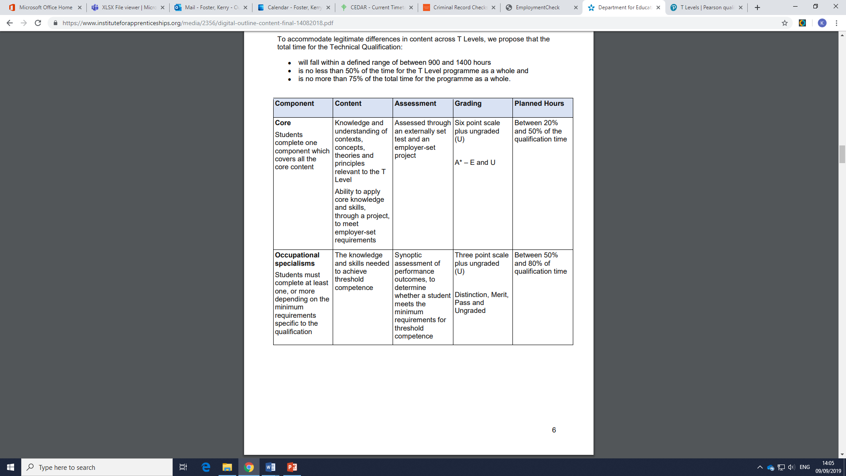
Course structure - Academic
The technical qualification is the responsibility of the Awarding Organisations and specifications are being finalised ahead of delivery.
The TQ is split into two sections:
Core content – assessed through an external exam
The Employer set project – assessed through a brief chosen by the student and marked by the AO.
Grades are provided A* - E combined for this component
Occupational specialisms are perfomance based assignments that are cross referenced to placement – Pass, Merit, Disctinction
Learners will be graded as P (high / low) ,M,D, D* overall

Slide 4
Course structure – Education and Childcare
Core content – 50% max of the overall qualification
12 elements
Exam 60 – 75%
Employer set project 25 – 40%
Year 1
Occupational Specialism 50 – 80% of the overall qualification
3 specialisms
Early years education and childcare
Supporting and mentoring students in FE and HE
Assisting teaching
Year 2
Maths, English and Digital skills
Employability and occupational specific requirements in consultation with employers
Industry placement – A minimum of 315 hours
Hours TBC in line with licence to practice for Early years education and childcare

Slide 5
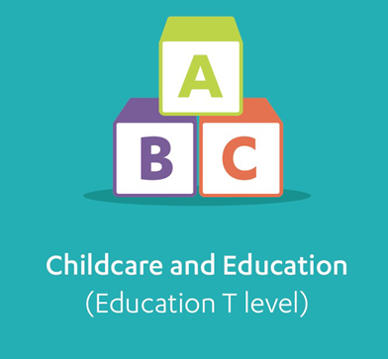
Core content – Education and Childcare A closer look
There are 12 elements that students will be taught and then assessed against through examination
Core pedagogy includes the following 12 key elements:
Wider Context
Child Development
Supporting Education
Safeguarding, Health and Safety and Wellbeing
Behaviour
Observation and Assessment
Equality and Diversity
Special Educational Needs and Disability
English as an Additional Language
Parents, Families and Carer’s
Working with Others
Reflective practice

Slide 6
Course structure – Digital
Core content – 50% max of the overall qualification
12 elements
Exam 60 – 75%
Employer set project 25 – 40%
Year 1
Occupational Specialism 50 – 80% of the overall qualification
4 specialisms
However only one has been confirmed for choice to date – others to follow:
Digital Production, Design and Development
Year 2
Maths, English and Digital skills
Employability and occupational specific requirements in consultation with employers
Industry placement – A minimum of 315 hours

Slide 7

Core content –Digital A closer look
There are 12 elements that students will be taught and then assessed against through examination
Core pedagogy includes the following 12 key elements:
Business Context
Culture
Data
Digital Analysis
Digital Environments
Diversity and inclusion
Learning
Legislation
Planning
Security
Testing
Tools

Slide 8

Industrial Placements
T-Levels
Placement Coordinators

Slide 9


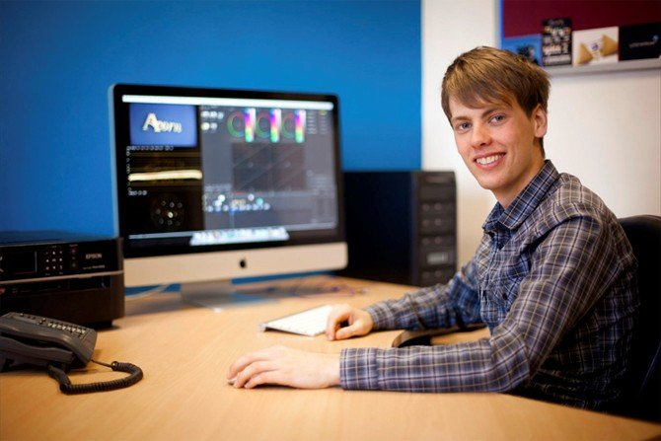
Industrial Placement
Industry placement- both strands
Learners are required to complete a minimum of 315 hours of placement experience.
This can be undertaken in two placement settings and include 35 hours maximum of work tasters.
As the Early Years Education and Childcare specialism awards a license to practice, the placement hours required is considerably more than 315 hours over the two-year course. However, the exact number of hours is to be confirmed. However, it is anticipated that this will include hours similar, to current awards of over 700 hours.

Slide 10
T-Level Placements
Need to complete at least 315 hours (approx. 45 days)
This will be monitored and students must complete in full in order to successfully complete the T-Level qualification
Students will be visited 3 times during their placement.
2 days weekly off timetable for placements

Slide 11

Preparation for Industrial Placement
Bespoke programme delivered alongside curriculum in Y12.
It can be modified to suit length of delivery available per department – i.e. Fast Track PFIP (6 weeks)/ Induction Days.
Aim to prepare the student for the task of undertaking Placement.
To assist students to appreciate the working environment and enhance their ability to perform to
To enable the student to reflect on and learn from experience.

Slide 12
Induction Programme – Preparation for Placement
Week | Topic
1 | Introduction to Placement
2 | Target Setting / Time Management
3 | Career Planning
4 | Creating CVs/ Cover Letters
5 | Safeguarding
Week | Topic
6 | Entering the Workplace
7 | Reflection Week
8 | Social Networking
9 | Ready for Placement?
10 | Expectations of placement recap

Slide 13
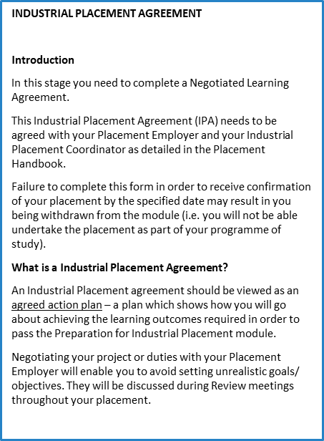
Industrial Placement Agreement
Sets foundations regarding expectations for both student and employer.
Details outcomes for example technical requirement as well as outcomes related to exposure in a real working environment.
Agreed and signed by all parties.

Slide 14

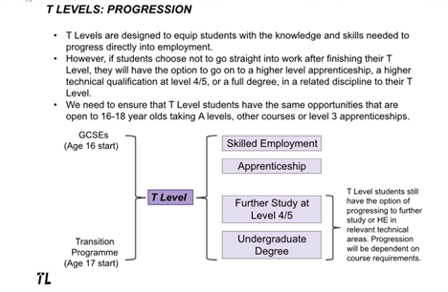
Progression routes
T Level completion will enable learner to progress into:
Skilled employment
Higher level apprenticeships at Level 4
Further study at Level 4 /5
HE courses – undergraduate degrees. Universities will recognise the value of T levels and Ucas have now awarded UCAS tarrif points.

Slide 15

Progression to HE –Ucas tarrif points
UCAS Tariff points | T Level overall grade
168 | Distinction*
144 | Distinction
120 | Merit
96 | Pass (C or above on the core)
72 | Pass (D or E on the core)

Slide 16
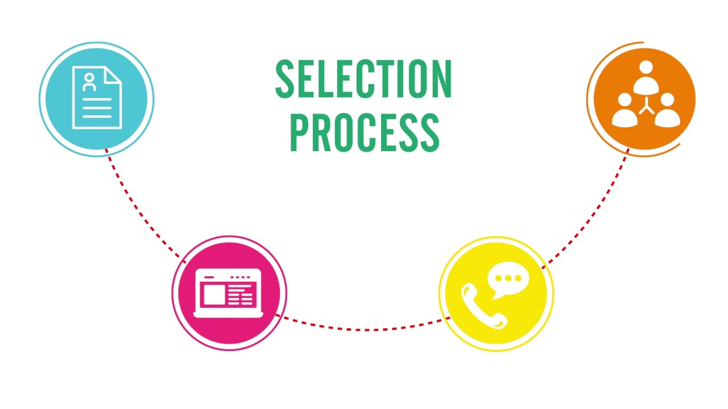
Our Selection Process for T levels 2020
Letter of Application
Selection Day in the summer term consisting of Group Activity & 1:1 interviews
Successful students will be matched with placements
Opportunity for placement provider to meet with student prior to start of placement

Slide 17
Childcare and Education and Digital: Digital Production, Design and Development
T level
Delivery in 2020

